Slide 1
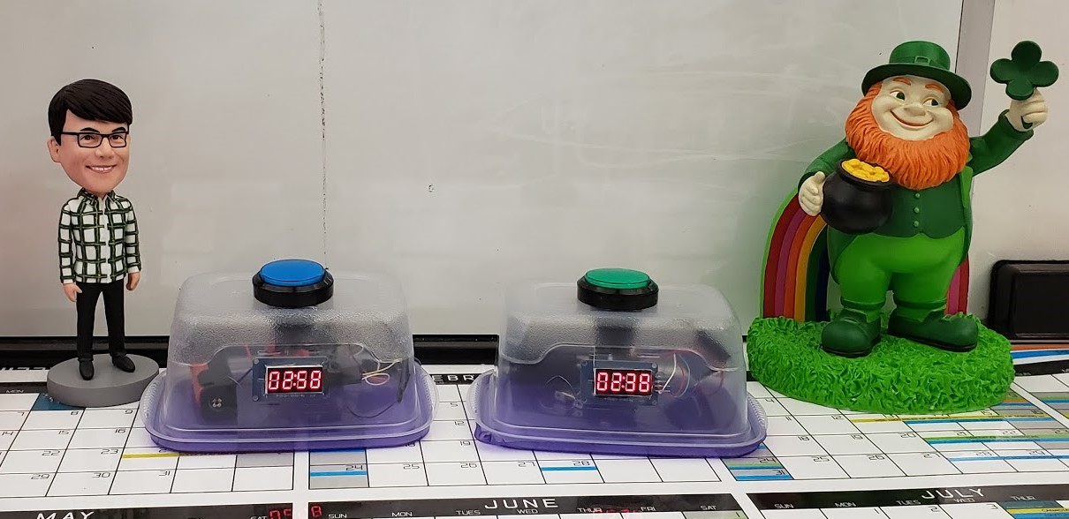
Doomsday Game Clock of Awesomeness
GEEKOUT#4
June 11, 2019

Slide 2
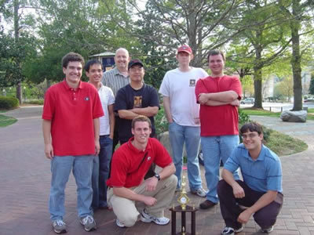
Previous Projects
“Chess Dawgs” Chess Club at University of Georgia
Founded 2006
Hosted tournaments
Took second in 2007 Georgia Open Collegiate Team Chess Championship
Created website
Recruited talent
Won first in state next 3 years in a row

Slide 3
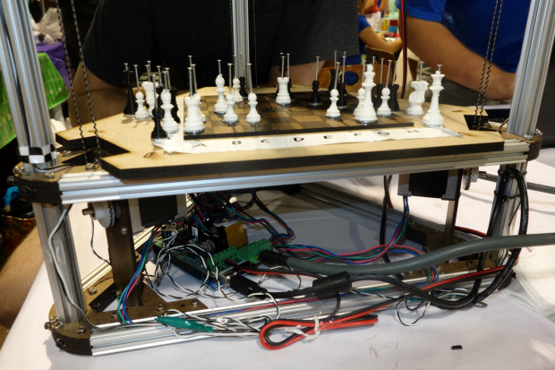
Previous Projects
Chess Playing Robot
Modified Rostock Delta 3D printer
Printhead exchanged for Electromagnet
.Net Command line interface
Reversible Chess Notation to G-Code

Slide 4
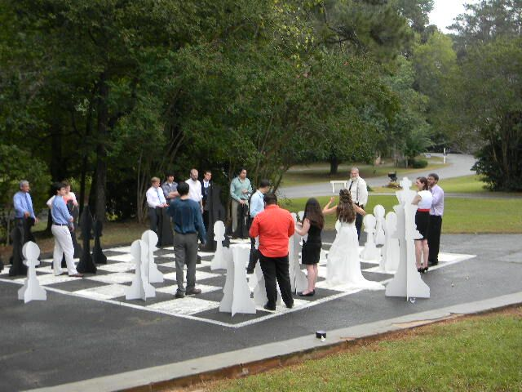
Previous Projects
Giant Chess
Slotted Hardboard

Slide 5
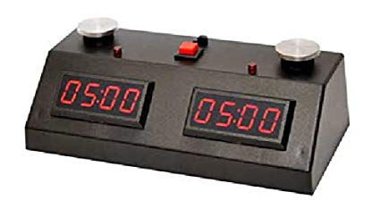
The Problem
Existing timekeeping devices are:
Hard to set up
Limited in features
Limited to two players
Require one player to use non-dominant hand

Slide 6
Solution
Make clock setup clear and easy using through webpage
Separate so each player can position clock where they want
Clocks can communicate over wifi
Any number of clocks can be used

Slide 7
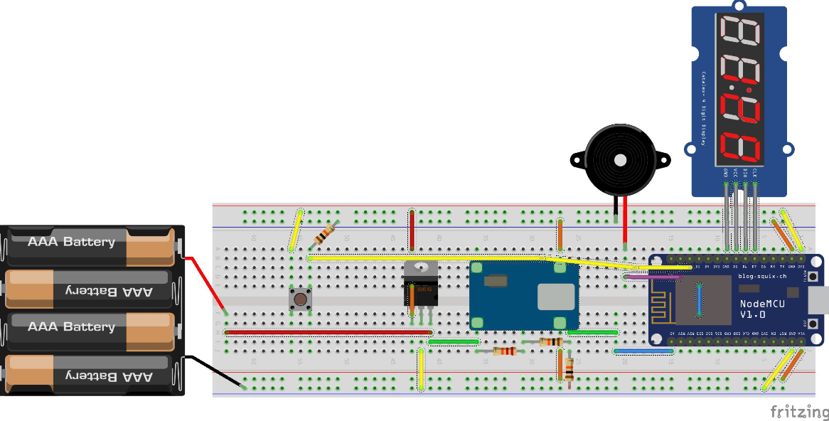
Design
Play laid out in Fritzing

Slide 8
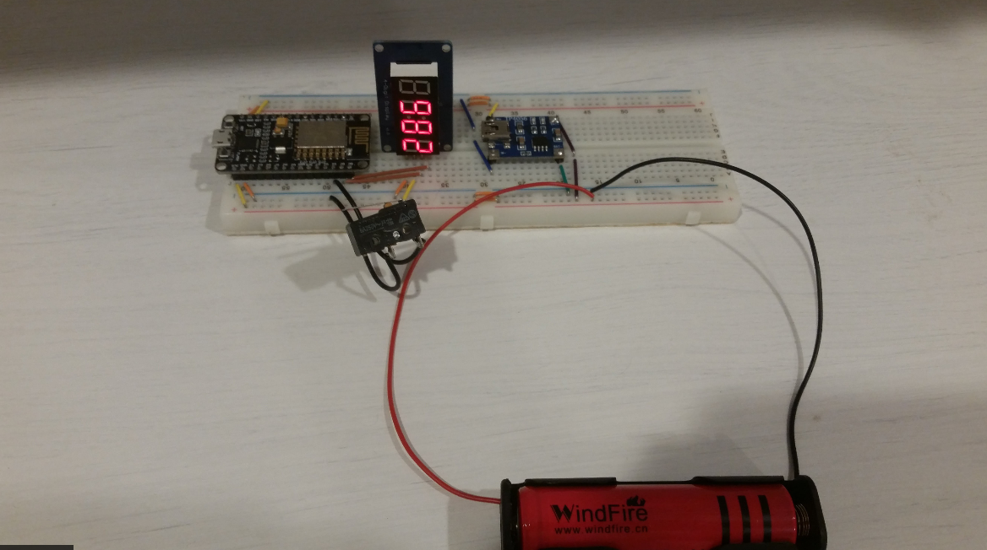
Prototype
Breadboard

Slide 9
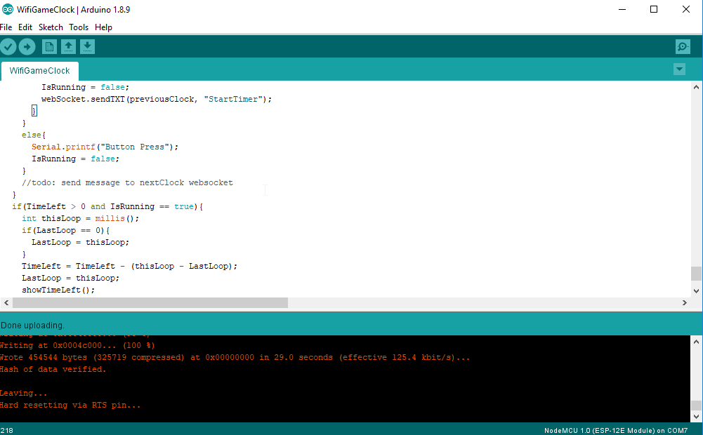
Code
Arduino IDE

Slide 10
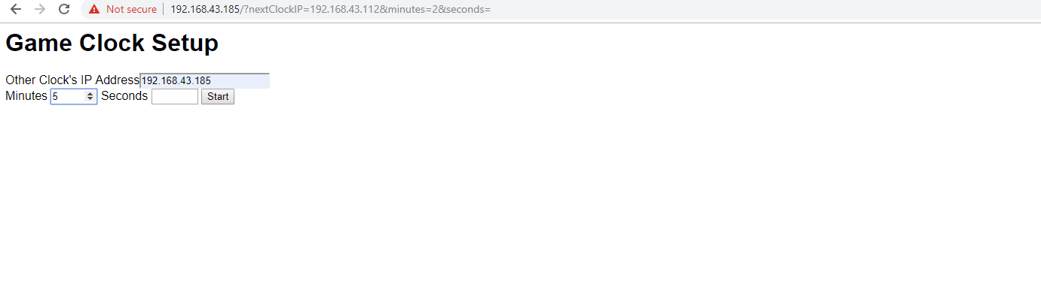
Web Interface

Slide 11
Plans for Improvement
Hardware
Add buzzer
Wire up button light
Build case out of Wood or Metal
Web Interface
Improve look and feel
Add different clock delay types
Allow user to save time settings
Code
Improve onboarding process
Make clocks aware of/discover eachother
Use Websockets

Slide 12
Questions?

